Slide 1
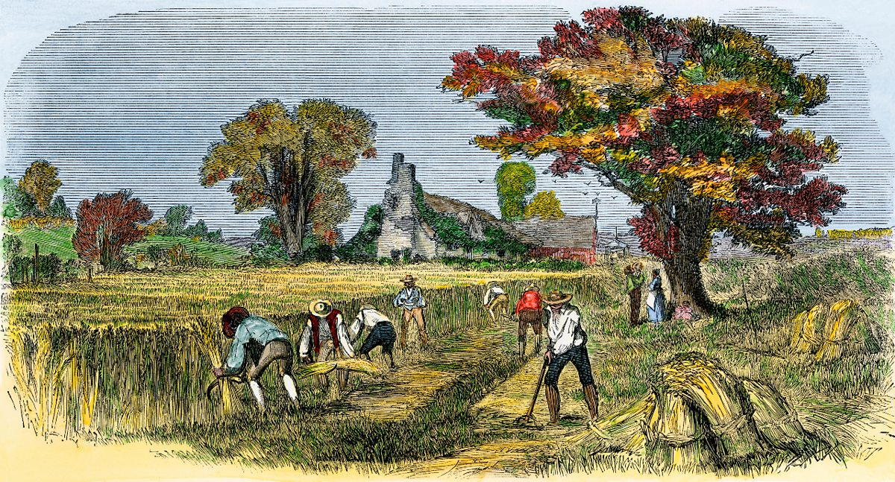
Notes:
Important points:
Designer has their own model – may not match users. They may not understand or even know about the user’s.
The way their model is communicated to user is via the system.

Slide 2
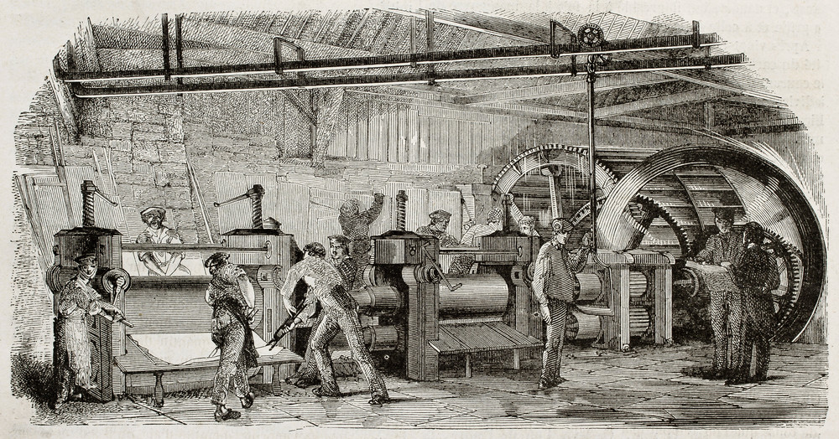

Slide 3
MMME4054 Week 7 – Human Error and Automation
Dr Kyle Harrington

Slide 4
Recap
What did you learn last week two weeks ago?
Notes:
Attention and workload

Slide 5
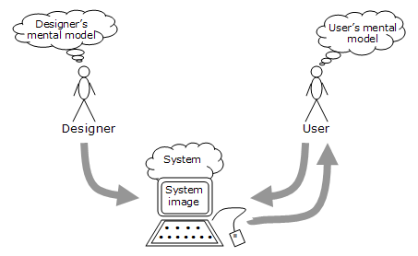
Mental models
Image source: Mental models | The Glossary of Human Computer Interaction (interaction-design.org), adapted from Norman, 1988
Notes:
Important points:
Designer has their own model – may not match users. They may not understand or even know about the user’s.
The way their model is communicated to user is via the system.

Slide 6
Skill, rule and Knowledge based behaviour (Rasmussen)​
Skills​
Sensorimotor performance which takes places as (more or less) automatic behaviour after a statement of intention​
e.g. Riding a bicycle​
Rules​
Goal-oriented performance controlled by a stored rule or procedure. The rule may have been derived from past experience or learned from other people’s experience​
e.g. Interpreting and acting upon familiar road signs​
Knowledge​
Goal-controlled or model-based behaviour used during unfamiliar situations. A plan is developed using knowledge, reasoning and experience to predict the outcome of actions​
e.g. Navigating in an unfamiliar environment

Slide 7
Knowledge in the head and knowledge in the world (Norman, 1988)
Property​ | Knowledge in the world​ | Knowledge in the head​
Retrievability​ | Retrievable whenever visible or audible​ | Not readily retrievable. Required memory search or reminding​
Learning​ | Learning not required. Interpretation substitutes for learning​ | Requires learning, which can be easier if there is meaning or structure to the material​
Efficiency of use​ | Tends to be slowed up by the need to find and interpret the external information​ | Can be very efficient​
Ease of use at first encounter​ | High​ | Low​
Aesthetics​ | Can be unaesthetic and inelegant, can lead to clutter​ | Nothing needs to be visible, which can lead to better aesthetics​
Notes:
Need to think:– is there enough of each to support successful task completion?

Slide 8
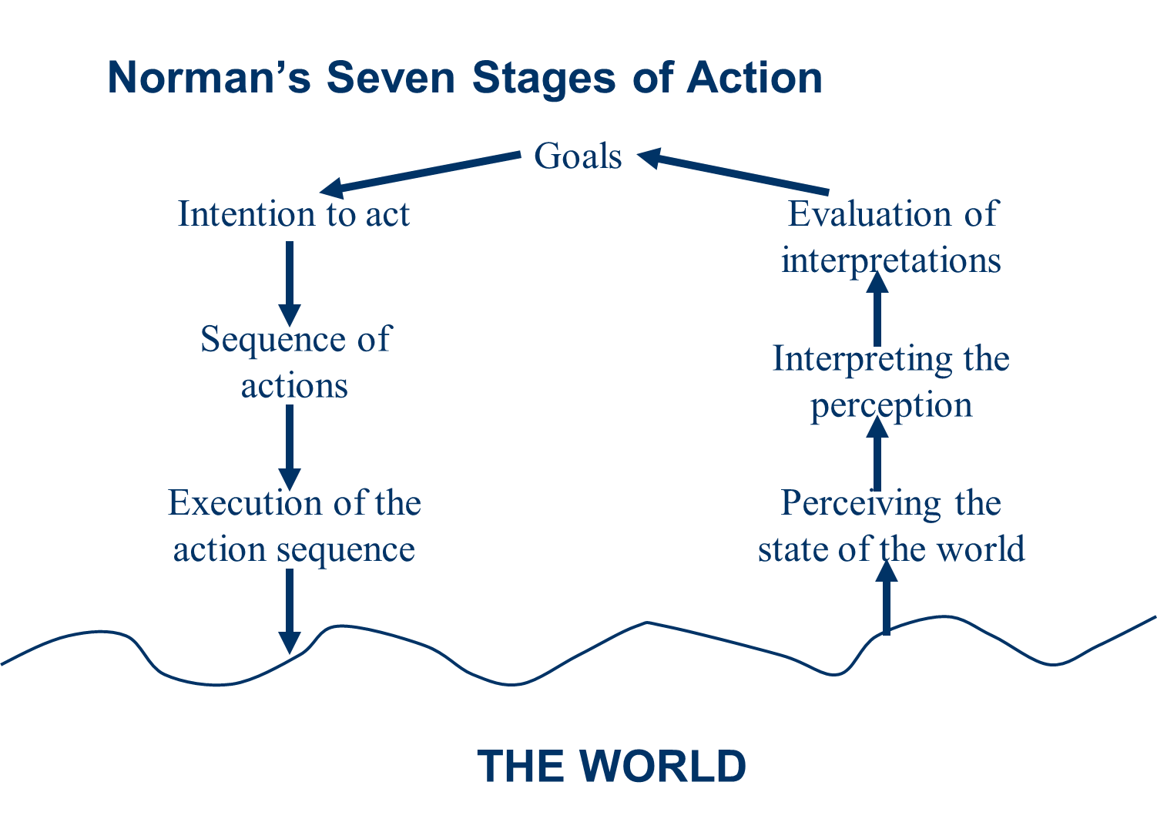
Norman’s Seven Stages of Action
Notes:
Norman’s seven stages – highlights when designer’s mental model doesn’t match the user’s mental model

Slide 9

Design to support Mental Models; Gestalt principles
Cues, affordances, constraints, mappings
Gestalt principles of design:
….
….
….
….
….
….
Image source: WWF

Slide 10
Answers
Cues, affordances, constraints, mappings
Gestalt principles of design:
Similarity
Continuation
Closure
Proximity
Symmetry
(Figure/ground)
Image source: WWF
10

Slide 11
Learning objectives – human error and automation
Module LO’s:
LO1 –Describe how humans process information and how this applies in a variety of working contexts.
LO3 –Critically analyse a variety of products and systems according to the extent that they support human behaviour and performance.
LO5 – Recognise the variety of products and work contexts to which cognitive ergonomics design practice and guidance can be applied.
Lecture objectives:
Understand impact of automation, including ironies of automation
Consider ironies of automation in the context of digital manufacturing
Consider ways of understanding and classifying human error

Slide 12
Recommended reading
Bainbridge, L., (1983). Ironies of automation. In Analysis, design and evaluation of man–machine systems (pp. 129-135). Pergamon.
Reason, J. (1990) Human Error. Cambridge: Cambridge University Press.​
Kirwan, B. (2015) Human Reliability Assessment. In Wilson, J and Sharples, S. Evaluation of Human Work. Boca Raton, CRC Press.

Slide 13
Automation

Slide 14
Automation
Automation: Machine (usually a computer) assumes a task that is otherwise usually performed by a human operator​
Automation may change requirements of human cognition, perception and workplace behaviour​
Classes of automation​
Perception​
Cognition​
Control​/action implementation
Notes:
Requirements on humans – instead of doing the task, may have to deal with errors in automation.
Work can become more about monitoring – and that can be difficult over almost any length of time, particular if process is unchanging.
Perception examples include: LiDAR, RADAR, automated vision systems – many used in cars. Help driver to *perceive* the other cars/pedestrians. Night vision. Alarms. Security sensor beeps in shopping malls.
cognitive automation is capable of simulating the human thought process in a computerised model in order to automatically learn, discover and make recommendations or predictions. Brings intelligence to information rich scenarios. Siri can think for you – sets your map location based on your diary – you don’t need to think. Using data to predict a trend in the future e.g. process control.
Decision making: can suggest a course of action, or implement it unless human vetos it. Or do it anyway
Control – controlling parts movement in manufacturing; control speed in adaptive cruise control; controlling steering in autonomous vehicles.
Automation can vary from none - to partial – to full

Slide 15
Brief History of Automation
Year / Period | Era / Context | Technological Changes | Changes to Work | Relevant Theory / Thinkers
Pre-1760 | Pre-industrial | Manual tools, human craft | Slow, generational change | —
1760–1840 | 1st Industrial Revolution | Steam engines, mechanized looms | Division of labour, de-skilling | Adam Smith (1776)
1900–1940 | Fordism & Scientific Management | Assembly lines, electrification | Mass production, time-motion studies | F.W. Taylor, Henry Ford
1940–1950s | Cybernetics & Early Computing | Control systems, early computers | Humans as monitors/controllers | Norbert Wiener (1948), Alan Turing (1950)
1950–1970s | Cognitive Revolution / GOFAI | Logic-based AI, automation in control | Operators supervise automation | Bainbridge (1983), emergence of HF
1980s–1990s | Digital Age | PCs, networks, software | Shift to info work, HCI | Norman (1988), Rasmussen
2000s–2010s | Connected Automation | Robotics, Internet, smart systems | Automation of admin/service | Reason (1990), Sharples & Wilson (2015)
2020s–present | AI / GenAI Era | Neural networks, large language models | Cognitive automation, co-creation | MABA–MABA revisited; Human–AI teaming
Notes:
Requirements on humans – instead of doing the task, may have to deal with errors in automation.
Work can become more about monitoring – and that can be difficult over almost any length of time, particular if process is unchanging.
Perception examples include: LiDAR, RADAR, automated vision systems – many used in cars. Help driver to *perceive* the other cars/pedestrians. Night vision. Alarms. Security sensor beeps in shopping malls.
cognitive automation is capable of simulating the human thought process in a computerised model in order to automatically learn, discover and make recommendations or predictions. Brings intelligence to information rich scenarios. Siri can think for you – sets your map location based on your diary – you don’t need to think. Using data to predict a trend in the future e.g. process control.
Decision making: can suggest a course of action, or implement it unless human vetos it. Or do it anyway
Control – controlling parts movement in manufacturing; control speed in adaptive cruise control; controlling steering in autonomous vehicles.
Automation can vary from none - to partial – to full

Slide 16
Why automate?
Dangerous tasks (e.g. teleoperation in chemical or nuclear environments)​
Impossible tasks (e.g. complex mathematical processes)​
Challenging tasks (e.g. automated diagnosis)​
Support to human performance (e.g. autopilots)​
Cost savings (e.g. robots in manufacturing)​
Speed (manufacturing)
Consistency and Precision (manufacturing, surgery, driving?, Administration)
Notes:
Econmics benefits: labour saving, improving efficiency, improving safety, and competitivity.
When carefully designed, can reduce human user’s workload – mental and physical (e.g. automated number/data processing vs. automatic assembly lines)
Disaster response robots

Slide 17
Problems with automation
Automation Reliability Issues​
Mistrust in system​
Impact on operator workload​
Job Satisfaction​
Issues of observability
Ironies of automation
Notes:
Deskilling – skills fade
SA can decline.
Automation generally changes the nature of cognitive tasks often in ways which are unintended by the designer. Human role becomes more rather than less important.
Issues often arise from a tech centred approach. Challenge is now to design for joint human-automated systems.
Reliability – nothing works at 100%.
Trust: overtrust (complacency) and under trust. Over complexity can lead to lack of trust; lack of transparency can lead to lack of trust. (e.g. navigation in week 2). Reliability is biggest concern. Out of the loop unfamiliarity – OOTLUF- have a trade off here between automation and reduced workload.
it is well-recognised within the HFE community that integrating automation into a workplace can have unintended consequences on human workers (Bainbridge, 1983). These can relate to suboptimal mental workload (MWL) (Young and Stanton, 2002), loss of situation awareness (SA) and out-of-the-loop decision making (Endsley and Kiris, 1995); these, in turn, can result in suboptimal system performance or even safety failures (Stanton, Chambers, and Piggott, 2001).
Job satisfaction – automation can lead to “fear of replacement” which can affect job satisfaction, particularly amongst lower skilled workers who jobs are at risk.
In general, automation can serve to “remove” operator from the process, making comprehension and take-over more difficult.
Observability: can’t see or understand complex processes

Slide 18
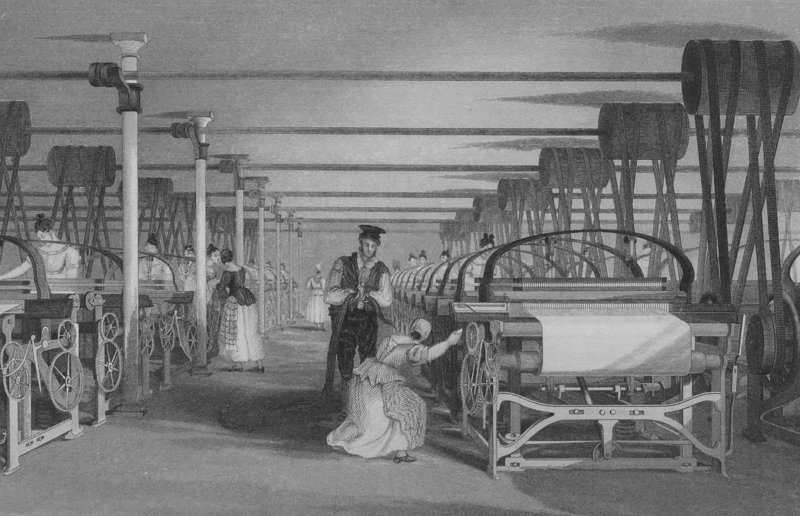
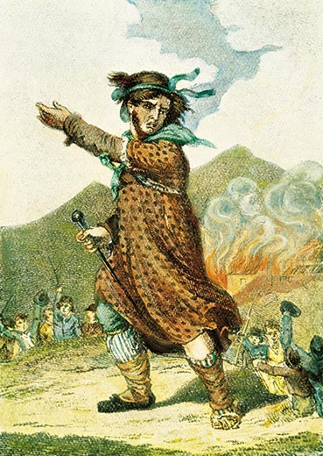
Industrial Revolution – First Automation (1760ish-1900)
Mass production largely replaces “hobbycraft” (at home manufacture)
Enclosures act forces many who were living from the land into the cities (1773)
Machines largely an extension of physical labour
Division of labour, but at the same time “deskilling”
First “true” large scale automation
Poor health and safety, waged work becomes more prominent, time implications that hobbycraft or peasant system did not have – time is money!
“One man draws out the wire, another straightens it, a third cuts it, a fourth points it, a fifth grinds it at the top for receiving the head... the important business of making a pin is, in this manner, divided into about eighteen distinct operations.” — Adam Smith, The Wealth of Nations, Book I, Chapter I
Some arguments and criticisms, include Luddites, and Marx
“Owing to the extensive use of machinery, and to the division of labour, the work of the proletarians has lost all individual character, and, consequently, all charm for the workman. He becomes an appendage of the machine, and it is only the most simple, most monotonous, and most easily acquired knack, that is required of him.” – Marx
Notes:
Econmics benefits: labour saving, improving efficiency, improving safety, and competitivity.
When carefully designed, can reduce human user’s workload – mental and physical (e.g. automated number/data processing vs. automatic assembly lines)
Disaster response robots

Slide 19

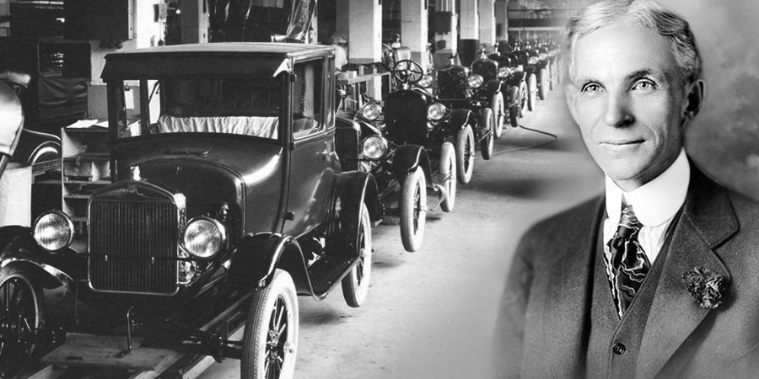
Fordism and Scientific Management (Early 1900s-WWII)
Electrification becomes widespread
Assembly lines, and mass production
Physiology, and Psychology becoming understood as sciences
Frederick Winslow Taylor (1911, The Principles of Scientific Management)
Efficient working studies, as a science.
Early time-motion studies (Gilbreths, 1910s) (still sometimes used in Human Factors)
Henry Ford extended the work of Taylor and applied it not just to tasks, but entire production lines (Socio-technical systems)
Workers components of the production process
Further automation, automation of thought, changing cognition to a rule-based system, reasoning replaced with repeatable consistent rules.
Focus not on “wellbeing” – but on optimising output, reducing costs, etc.
Notes:
Econmics benefits: labour saving, improving efficiency, improving safety, and competitivity.
When carefully designed, can reduce human user’s workload – mental and physical (e.g. automated number/data processing vs. automatic assembly lines)
Disaster response robots

Slide 20
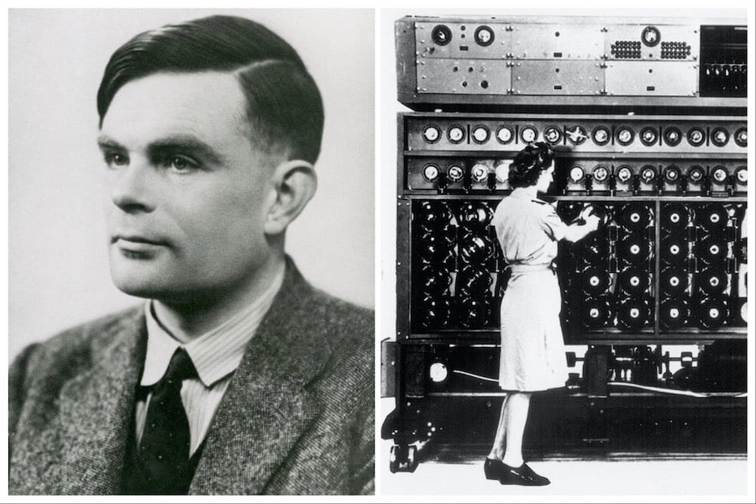
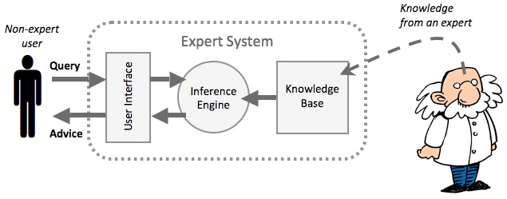
Birth of the Computer Age (1940s-1980s)
Alan Turing, Von Neuman and others develop digital computers
First possibility of automating cognition
AI optimism, “Can Machines Think?” - Turing
Rule-based AI systems
Cognition as the manipulation of symbols.
Symbolic Logic, and explicit reasoning. “Expert Systems”
AI and automation was very good in narrow domains, but could not learn of generalise
Human Factors emerges as a discipline; in US this was much more related to military applications, in Europe, early ergonomics and design.
Emergence of “white collar” automation, office computers, typing, filling.
Routine cognitive tasks can be automated.
Manufacturing, production and traditional “blue collar” work continues in the global north, but prevalence begins to decline towards end of this period.
Cognitive science begins during the end of this period, mind as information processor
Notes:
Econmics benefits: labour saving, improving efficiency, improving safety, and competitivity.
When carefully designed, can reduce human user’s workload – mental and physical (e.g. automated number/data processing vs. automatic assembly lines)
Disaster response robots

Slide 21
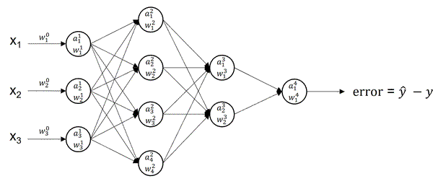
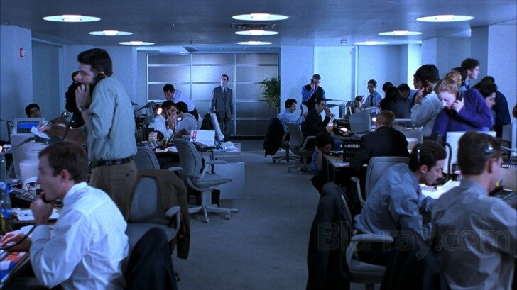
Connection, Complexity and Machine Learning (1980s-2010s)
Rapid decrease in “blue collar” manufacturing in the Global North, deindustrialisation
Production and extraction work, largely outsourced to global South
Service work, cognitive work begins to become increasingly complex
Complex systems, Systems ergonomics replaced views of linear control
Safety critical domains apply cognitive engineering (health, nuclear, aviation, transport, etc).
Human Factors becomes prominent (Hollnagel, Woods, Rasmussen, Reason)
Automation becomes displaced, invisible and embedded in digital infrastructures
Change of focus from human error to system resilience
Adoption and role out of internet creates a more connected world
GOFAI starts being replaced with machine learning, neural networks, less traceable.
AI outputs can generalise, but can behave in unexpected ways, not reliable, but general
Notes:
Econmics benefits: labour saving, improving efficiency, improving safety, and competitivity.
When carefully designed, can reduce human user’s workload – mental and physical (e.g. automated number/data processing vs. automatic assembly lines)
Disaster response robots

Slide 22


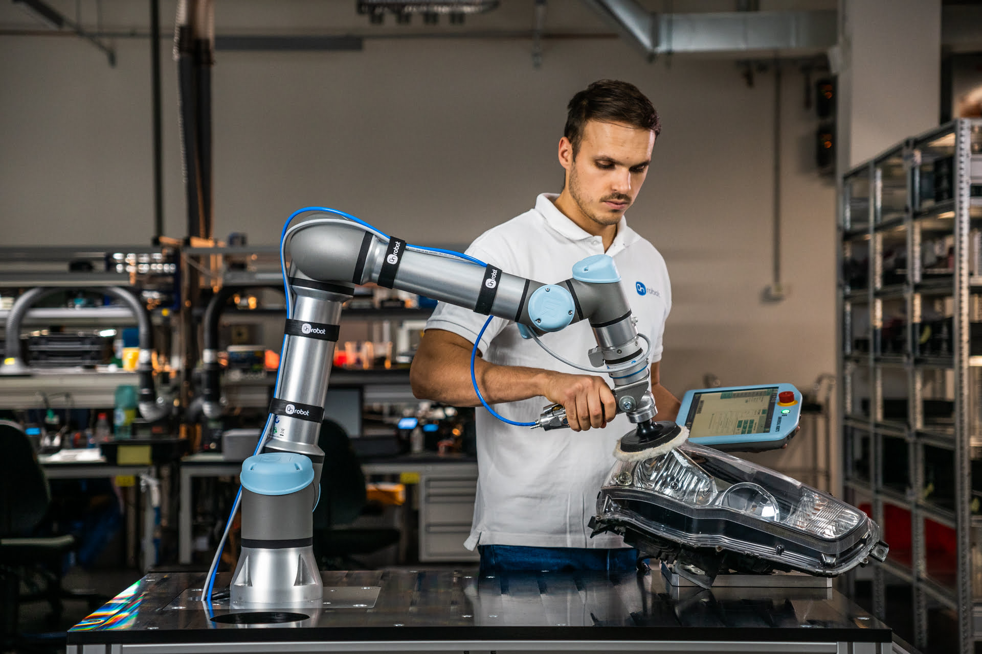
The birth of GenAI, the Present and the Future (2010s-Present)
Widespread adoption of mobile phones, increasing communication
“Always on” work culture of many jobs, expectation that emails are answered outside of office hours
More “service” jobs, internet jobs, “influencer”, “content creator”, “prompt engineer”?
Birth of GenAI
“My boss is an app and I owe it money”
Human roles become data entry or supervisory layers for automated systems
Humans must now collaborate with automation
Datafication of everything, human performance monitored, analysed.
AI interviews?
Co-bots, Human Machine Interactions
Notes:
Econmics benefits: labour saving, improving efficiency, improving safety, and competitivity.
When carefully designed, can reduce human user’s workload – mental and physical (e.g. automated number/data processing vs. automatic assembly lines)
Disaster response robots

Slide 23
Principles of Automation (Balfe)
Principle | Description
Reliable | The automation should function consistently.
Competent | The automation should perform tasks correctly given the information that is input.
Visible | All decision relevant information for a given situation should be available to the operator.
Observable | Automation should provide effective and immediate feedback to the operator allowing him/her to maintain awareness of system state.
Understandable | Decisions made by the automation should be understandable to the operator given the current state of the system and environment.
Directable | The operator should be able to direct the automation easily and efficiently.
Robust | The automation should be able to perform under a variety of conditions, not just normal operating conditions.
Accountable | The operator should be responsible for overall performance and therefore in charge of the automation.
Proactive Control | The system should support the operator in predicting and controlling ahead rather than controlling reactively.
Skill Degradation | The automation should incorporate a method to guard against operator skill degradation.
Balfe, N., Wilson, J.R., Sharples, S. and Clarke, T., 2012. Development of design principles for automated systems in transport control. Ergonomics, 55(1), pp.37-54.
Notes:
This paper reports the results of a qualitative study investigating attitudes towards and opinions of an advanced automation system currently used in UK rail signalling. In-depth interviews were held with ten users, key issues associated with automation were identified and the automation’s impact on the signalling task investigated. The interview data highlighted the importance of the signallers’ understanding of the automation and their (in)ability to predict its outputs. The interviews also covered the methods used by signallers to interact with and control the automation, and the perceived effects on their workload. The results indicate that despite a generally low level of understanding and ability to predict the actions of the automation system signallers have developed largely successful coping mechanisms that enable them to use the technology effectively. These findings, along with parallel work identifying desirable attributes of automation from the literature in the area, were used to develop 12 principles of automation which can be used to help design new systems which better facilitate cooperative working.

Slide 24
Ironies of Automation (Bainbridge, 1983)
Bainbridge (1983) – derived from process control​
Designer who tries to eliminate the operator still leaves the operator to do the tasks which the designer cannot think how to automate​
Physical skills deteriorate when they are not used​
Formerly experienced operator who has been monitoring an automated process may now be an inexperienced one​
Operator will only be able to generate successful new strategies for unusual situations if he has an adequate knowledge of the process​
Efficient retrieval of knowledge from long term memory depends on frequency of use​
Operator unable to make decisions based on wide knowledge of the plant state if has not previously spent time reviewing system state
Notes:
Even highly automated systems require humans for supervision, adjustment, maintenance, expansion, improvement
Irony: the more advanced a control system is, the more crucial the role of the human operator
Human operator can be left with arbitrary collection of tasks – the ones which are hard to automate.
After automation – tasks may include monitoring, and if that fails, may have to do the task themselves (e.g. driving)
Doing a task which the operator is not familiar with will increase their workload
Point 4 makes reference to “situation awareness” concepts – e.g. coming onto a shift early to understand what’s going on; only being able to make decisions if actively involved in process.
THE classic aim of automation is to replace human manual control, planning and problem solving by automatic devices and computers. However, as Bibby and colleagues (1975) point out: "even highly automated systems, such as electric power networks, need human beings for supervision, adjustment, main.tenance, expansion and improvement. Therefore one can draw the paradoxical conclusion that automated systems still are man-machine systems, for which both technical and human factors are important." This paper suggests that the increased interest in human factors among engineers reflects the irony that the more advanced a control system is, so the more crucial may be the contribution of the human operator.
3. Point 3 is about moving from monitoring task to doing the work – physical skills deteriorate

Slide 25
Ironies of Automation (continued)
Bainbridge (1983) – derived from process control​
Impossible for even highly motivated human being to maintain effective visual attention towards a source of information where low level of activity for more than about 30 minutes​
Automatic control system has been put in because it can do the job better than the operator, but yet the operator is being asked to monitor that it is working effectively​
Computer makes decisions quickly, therefore no way in which human operator can check in real-time that the computer is following its rules correctly​
If job perceived as being “deskilled” by being reduced to monitoring, negative effect on operator attitudes​
Deskilled workers may insist on high pay level as remaining symbol of status which is no longer justified by job content​
Notes:
1 – from studies of vigilance
4 – skill is linked to status – deskilled worker might want high pay
Solutions:
Give operator assistance for monitoring low probability events
Use displays to help monitor performance
Use hands-on control for a short period for each shift (or simulator training)
Fitt’s approach (allocation of function of what each is best at doing) is no longer sufficient – it doesn’t consider the integration of human and machine.

Slide 26
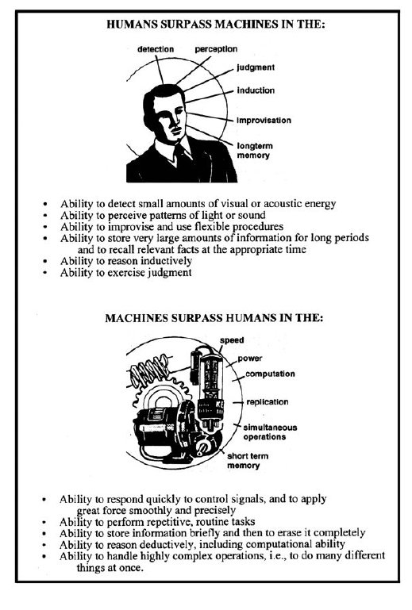
Fitts HABA-MABA (1951)
Notes:
1 – from studies of vigilance
4 – skill is linked to status – deskilled worker might want high pay
Solutions:
Give operator assistance for monitoring low probability events
Use displays to help monitor performance
Use hands-on control for a short period for each shift (or simulator training)
Fitt’s approach (allocation of function of what each is best at doing) is no longer sufficient – it doesn’t consider the integration of human and machine.

Slide 27
Fitts HABA-MABA (1951)
Humans Better at (in 1951) | Machines Better at (in 1951) | Humans Better at (Today | Gen AI better at (Today)
Improvising and being flexible | Responding Quickly
Detecting small amounts of visual or acoustic energy | Applying great force smoothly and precisely
Judgement | Routine Tasks
Reasoning INDUCTIVELY | Reasoning DEDUCTIVELY
Seeing Patterns | Operating in hostile Environments
Store a large amount of information and recall it appropriately | Storing information quickly and then erasing it
Notes:
1 – from studies of vigilance
4 – skill is linked to status – deskilled worker might want high pay
Solutions:
Give operator assistance for monitoring low probability events
Use displays to help monitor performance
Use hands-on control for a short period for each shift (or simulator training)
Fitt’s approach (allocation of function of what each is best at doing) is no longer sufficient – it doesn’t consider the integration of human and machine.

Slide 28
Human Error

Slide 29
Human Error - Definitions
Human error = inappropriate or undesirable human decision or behaviour that reduces, or has the potential for reducing, effectiveness, safety or system performance.​
Undesirable effect or potential effect on system or on people​
Does not have to result in degraded system performance or an undesirable effect on people to be considered an error​
Should consider the entire system and not focus on only the operator

Slide 30
Methods of error classification
Active Failure​
Effects felt almost immediately​, and “at the sharp end” usually operator “error”, often with direct results (incorrect medication given to patient, wrong turn made in a car, wrong button pressed)
Latent Failure​
May lie dormant within a system for a long time​
Often systemic, unnoticed, “hidden”, could be organisational, interface design, work culture, inadequate training, etc
“rather than being the main instigators of an accident, operators tend to be the inheritors of system defects created by poor design, incorrect installation, faulty maintenance and bad management decisions” ​
What went wrong, vs how is it possible for that to go wrong?
(Reason, 1990)
Notes:
From HSE:
Classification of Human Errors - Latent and Active Failures
Active failures - these are the 'errors' made by operators/maintenance staff ie those with hands-on control of the system/equipment. They occur immediately prior to the accident event and are often seen as the 'immediate cause'. Active failures are those errors which traditionally have been described as human error - driver error and pilot error being typical examples.
Latent Failures - these are decisions and actions that dormant in an organisation for some time until revealed by active failures. These are evident in poor procedures, poor design, inadequate training, poor attitudes to safety.
The Health and Safety Executive (HSE) uses the {latent} adjective to describe failures made by "designers, decision makers and managers" and contrasts latent failures with active failures, the errors made by "those with hands-on control of the system". The HSE explains that the timescales are different -- active failures occur immediately before the accident and are therefore synonymous with "immediate cause" while latent failures will be dormant for some time. HSE references equate them as both "root causes" and "underlying causes".
The HSE says: "Latent failures provide as great, if not a greater, potential danger to health and safety as active failures. Latent failures are usually hidden within an organisation until they are triggered by an event likely to have serious consequences."
The idea of latent failures was made popular in James Reason's Swiss cheese model. This suggests that, given we know that active failures will occur, systems are built with multiple layers of defence. These safeguards include procedural and administrative controls, as well as engineering controls such as monitors, alarms and physical barriers. If all the safeguards were perfect, all active failures would be caught, and accidents prevented. However, because of latent failures or latent errors there are holes in each layer of safeguarding. When the holes in each barrier line up, an active failure will cause an accident.

Slide 31
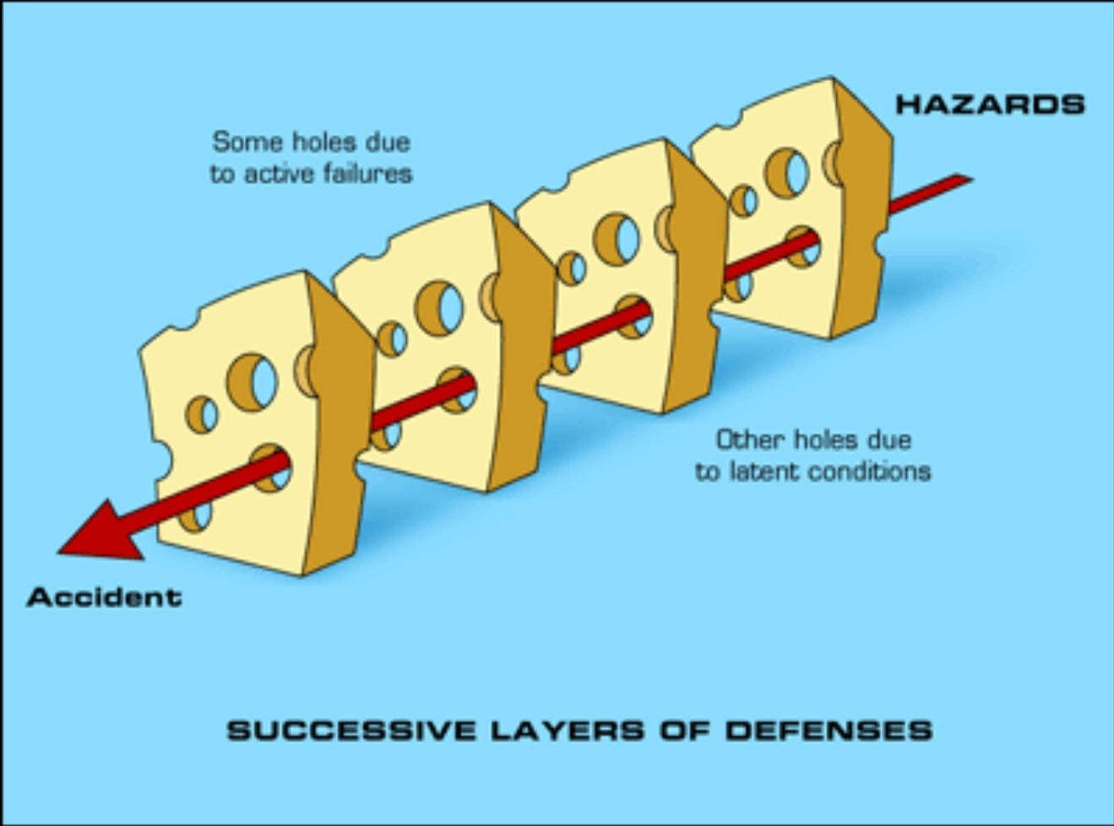
Swiss Cheese Model (Reason 1900)
Reason and COVID

Slide 32
Reason (1990)
Depict the intent behind the “error”​
Slips/lapses​
Occur when the correct way of performing an action is known, but, often due to a lapse of attention, it is performed wrongly​
Mistakes​
The use of an inappropriate action for the situation​
Violations​
Deliberate decision to perform what is known to be an inappropriate or unsafe act​
Notes:
According to Reason (1990), the types of human failure are few in number. In fact, safety critical organizations categorized these errors into two major categories which are deliberate erroneous conducts and unintended conducts (Dyer and Scagnoli, 2020). The deliberate errors are violations while slips, lapses and mistakes are types of unintended errors also known as human failure. The main distinction is that mistakes are the result of planning errors (e.g., opting to pass a dangerous path through a work area on purpose), whereas slips and lapses are the consequence of implementation failure such as inattentiveness, distraction.

Slide 33
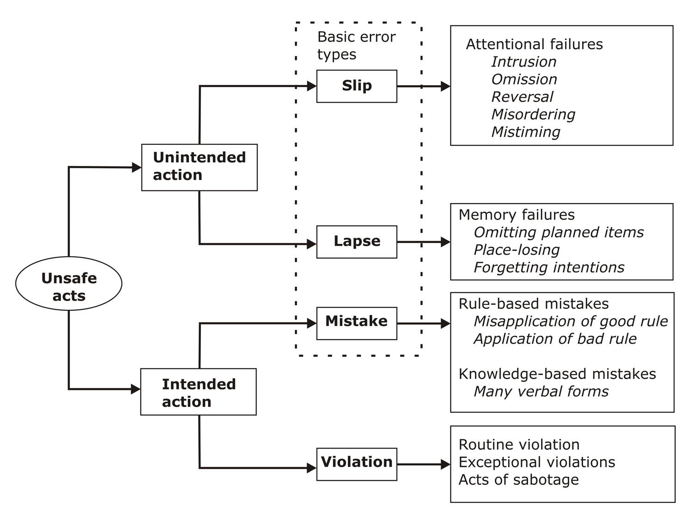
Psychological varieties of unsafe acts (Reason)
Skill
Execution
Rule
Knowledge
Planning
Image source: D'source Human Error | Human Error and Reliability | D'Source Digital Online Learning Environment for Design: Courses, Resources, Case Studies, Galleries, Videos (dsource.in), based on Reason, 1990
Notes:
The Skill, Knowledge, Rule (SKR) taxonomy of human errors was proposed by Rasmussen (1982) as a useful framework for recognising and grouping the various forms of human errors and not violations. Human errors are divided into two categories in the SKR framework: execution and planning errors. A skill-based error occurs when someone has evidently failed to implement or practically perform the critical task in a satisfactory manner such as when one forgets to arrange something in the proper order or skips a step in a process.
The most prevalent errors are skill-based errors, which occur when a person has the necessary abilities, has a lot of experience, and is very familiar with the routine and regulations, yet unwittingly commits an error (Rasmussen, 1982; Salminen and Tallberg, 1996). Examples of skills-based errors includes when one misses a step, hit the wrong button, loosen instead of tightening something, or performs any action on autopilot (Dyer and Scagnoli, 2020). Slips and lapses are examples of skills-based errors.
Slips and lapses can be defined as errors that occur as a result of a failure in the implementation and/or storage stage of an action cycle, irrespective of whether or not the plan that directed them was suitable to accomplish their goal (Reason, 1990). Workers make these errors when they fail to make a cognitive attentional check due to:
Strong habitual intrusions in which the procedure or behaviour is not frequent
Omission in which one is prevented from making the essential checks because of distractions
Mistimed checks that occur when workers underestimate intervals within a series of actions
There are two types of execution errors, namely slips and lapses. Slips are those errors induced by distractions in a familiar work environment which makes workers not to do what they are supposed to do while lapses are those caused by failures in memory that is when workers forget to do something (Hallowell, 2010; Mariana, Sahroni and Gustiyana, 2018; Cak, Say and Misirlisoy, 2020). Slips and lapses are likely to be significantly impacted by mental fatigue because errors are usually generated by errors or inadequacies in cognitive processes at precise points in time (Hallowell, 2010).
Attention may only be devoted to a tiny portion of a total space at any given moment and in order to avoid errors and accidents (Reason, 1990), it is essential that attention be centred on significant issue spaces. Care must be taken for workers not to be fatigued as this ability to focus declines significantly as people get more exhausted (Hallowell, 2010). Safety critical organizations employs the use of checklists to avoid error due to memory failures as people perform critical tasks under pressure.
Actions by human operators can fail to achieve their goal in two different ways: The actions can go as planned, but the plan can be inadequate, or the plan can be satisfactory, but the performance can still be deficient (Hollnagel, 1993).
Errors can be broadly distinguished in two categories:
Category 1 - A person intends to carry out an action, the action is appropriate, carries it out incorrectly, and the desired goal is not achieved. - An execution failure has occurred. Execution errors are called Slips and Lapses. They result from failures in the execution and/or storage stage of an action sequence. Slips relate to observable actions and are commonly associated with attentional or perceptual failures. Lapses are more internal events and generally involve failures of memory.
Category 2 - A person intends to carry out an action, does so correctly, the action is inappropriate, and the desired goal is not achieved - A planning failure has occurred. Planning failures are Mistakes. “Mistakes may be defined as deficiencies or failures in the judgmental and/or inferential processes involved in the selection of an objective or in the specification of the means to achieve it.” (Reason, 1990).

Slide 34
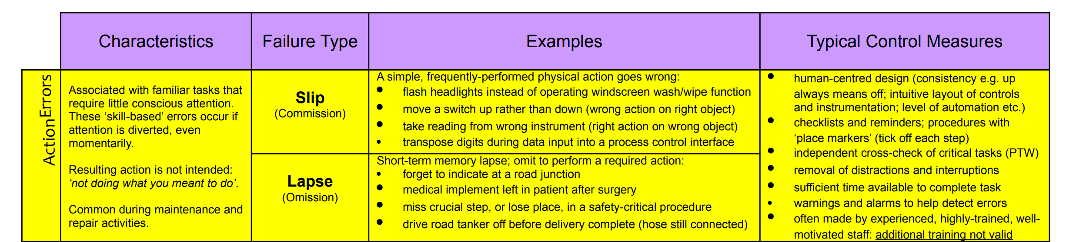
Human Failure types: Action errors
Human failure types (hse.gov.uk)
Notes:
Mum took me driving lessons – when we got home, she pulled umbrella out of the door pocket – right action on wrong object – slip
Dad was locking house and left keys in door when mum asked him something – omission (failure to take keys out of door) - lapse

Slide 35
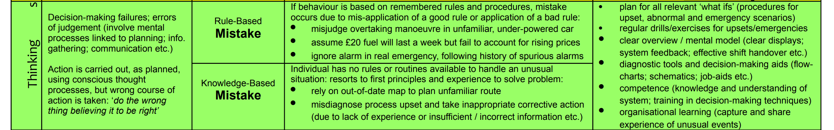
Human Error types – thinking errors
Human failure types (hse.gov.uk)
Notes:
Evacuation – leave building via most familiar exit rather than closest or signposted exit
Choosing the wrong statistical test for a study

Slide 36
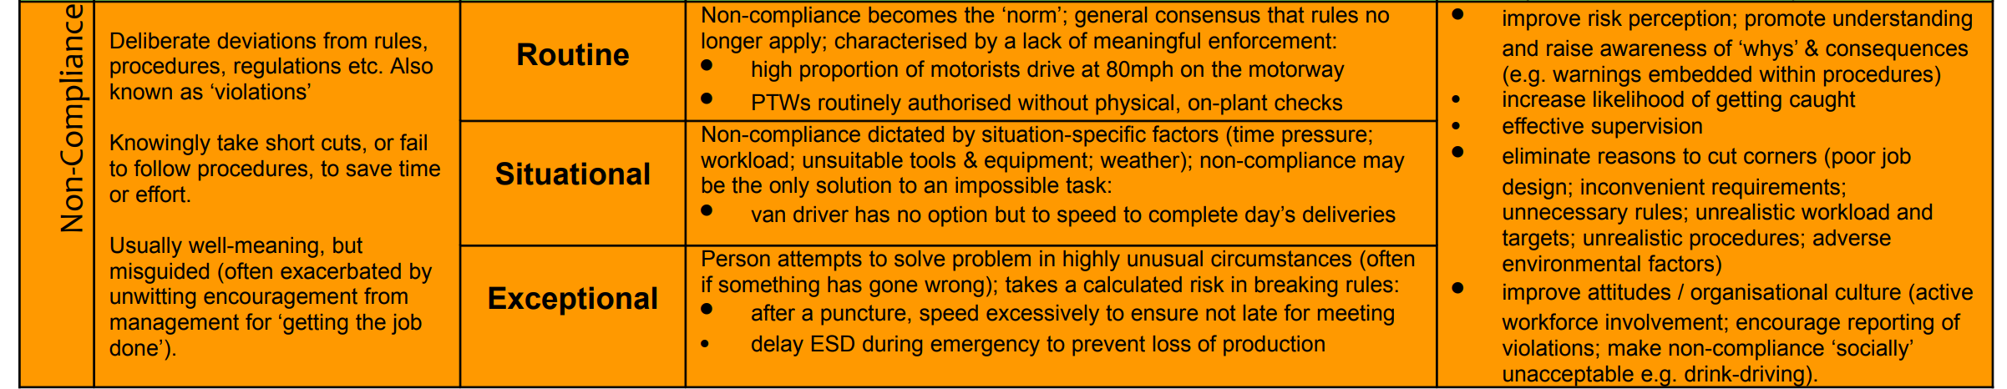
Human error types – non compliance (violations)
Human failure types (hse.gov.uk)

Slide 37

Human error
Situation: Locking the car leaving the keys inside
Analysis:
Active Error : As impacts of the error are seen almost immediately Especially when you need to rush back home carrying loads of groceries :P
Definitely, an unintended action
Lapse : You know you’ve to carry the key but due to lapse, you forget it inside (Could happen while multitasking generating cognitive workload).
Solution: Fortunately, nowadays, cars have sensors that do not let you lock the car, if the keys are inside

Slide 38
What variety of “unsafe act” are the following?
Cheating on a test
Accidentally saying one word when you mean to say another
Leaving your phone at home by accident
Using an incorrect formula on a maths exam
Giving an incorrect answer on one of the weekly quizzes (which you believe to be correct)
Making a bad move in Chess
Speeding in a car
Whilst playing your favourite computer game, accidentally pressing the wrong button
Forgetting to take your daily medication
Clicking “I have read the terms and conditions”, when you absolutely have not
Violation (exceptional/situational)
Slip
Lapse
Mistake (rule or knowledge)
Mistake (rule or knowledge)
Mistake
Could be any!
Slip
Lapse
Violation
Notes:
GEMs – the application of Rasmussen’s SRK ideas in the area of human error identification.
GEMs is an attempt to integrate error at SB, RB, KB.
SB=preprogrammed behavioural sequences, with checks. Check if actions are running to plan, and if goal is being achieved. Slilps and lapses depend upon failures of attentional checking – either inattention (failure to make a check) or overattention – checks at inappropriate points.
Humans are strong pattern recognisers – rather than calculate or optimise – i.e. when given a problem, humans are strongly biased towards solutions at RB level rather than more effortful kB level. Inclination to exit along “is pattern familiar?” route in RB. Only with cycles of this failing to offer a satisfactory solution will they move to KB. Here, they will still tend to RB. Strong bias towards simplifying problems based on existing patterns/rules.
Can be applied to determine the type of behaviour that has led to, or could lead to, an error.
In particular, helps distinguish between slips and mistakes.
Slip=departure of action from intention (the operator knows what to do, but does the wrong thing)
Mistakes = operator acts according to plan, but selects inadequate plan to achieve the desired outcome.
Importantly, S&M are caused by different behavioural processes and need to be eradicated by different solution.
e.g. slips might be lack of attention – these are already experts so training would not be of use.

Slide 39
Which of these are latent and which are active failures?
A workplace culture that does not protect whilst blowers
Turning the wrong way down a one way street
Forgetting to press record on the situation awareness lecture
A door lock which gets a bit stuck sometimes
An alarm system which is hard to understand
Not noticing a step and tripping over
A difficult to notice step – not clearly marked
A poorly designed coffee cup which you can’t hold properly
Spilling your coffee
A lack of appropriate first aid training for sports coaches
Latent
Active
Active
Latent
Latent
Active
Latent
Latent
Active
Latent
Notes:
GEMs – the application of Rasmussen’s SRK ideas in the area of human error identification.
GEMs is an attempt to integrate error at SB, RB, KB.
SB=preprogrammed behavioural sequences, with checks. Check if actions are running to plan, and if goal is being achieved. Slilps and lapses depend upon failures of attentional checking – either inattention (failure to make a check) or overattention – checks at inappropriate points.
Humans are strong pattern recognisers – rather than calculate or optimise – i.e. when given a problem, humans are strongly biased towards solutions at RB level rather than more effortful kB level. Inclination to exit along “is pattern familiar?” route in RB. Only with cycles of this failing to offer a satisfactory solution will they move to KB. Here, they will still tend to RB. Strong bias towards simplifying problems based on existing patterns/rules.
Can be applied to determine the type of behaviour that has led to, or could lead to, an error.
In particular, helps distinguish between slips and mistakes.
Slip=departure of action from intention (the operator knows what to do, but does the wrong thing)
Mistakes = operator acts according to plan, but selects inadequate plan to achieve the desired outcome.
Importantly, S&M are caused by different behavioural processes and need to be eradicated by different solution.
e.g. slips might be lack of attention – these are already experts so training would not be of use.

Slide 40
Implications for design
Building in reslience to a system to reduce negative impact of human error​
Provide cues to important information to support appropriate skill, rule and knowlege-based behaviours
Consider the impact on the human when designing automation – or better yet, design specifically for human needs!

Slide 41
Any questions? Kyle.Harrington@nottingham.ac.uk

